Slide 1

Positional Self-Attention with Co-Attention
^{for Video Question Answering}
Xiangpeng Li, Jingkuan Song, Lianli Gao, Xianglong Liu, Wenbing Huang, Chuang Gan, Xiangnan He
University of Electronic Science and Technology of China

Slide 2
Outline
Introduction
Related Work
Proposed Method
Experiments and Results

Slide 3
Outline
Introduction
Related Work
Proposed Method
Experiments and Results

Slide 4

Introduction
Problem Statement
Video Question Answering: answer the question based on given video
Question: What does the man do before laugh?
-----
Sit on the chair
-----
-----
-----

Slide 5
Outline
Introduction
Related Work
Proposed Method
Experiments and Results

Slide 6
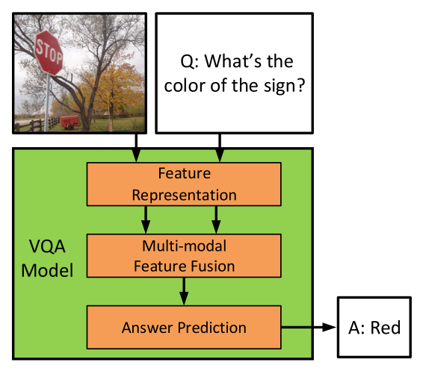
Related work
Basic Visual Question Answering structure
Traditional RNN (LSTM, GRU …)
[1] Zhou Yu, Jun Yu. Beyond Bilinear: Generalized Multi-model Factorized High-order Pooling for Visual Question Answering

Slide 7
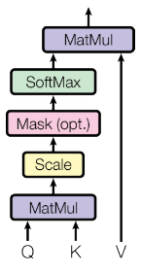
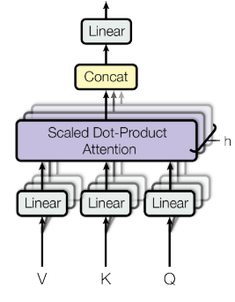
Related Work
Self-Attention Mechanism
Scale-Dot product Attention
Multi-Head Attention
[1] Ashish Vaswani, Noam Shazeer. Attention is all you need NIPS 2017

Slide 8
Outline
Introduction
Related Work
Proposed Method
Experiments and Results

Slide 9
Proposed Method
Motivations
1. LSTM has weakness in modeling the long range dependencies
2. Traditional RNN cannot encoding data in parallel

Slide 10
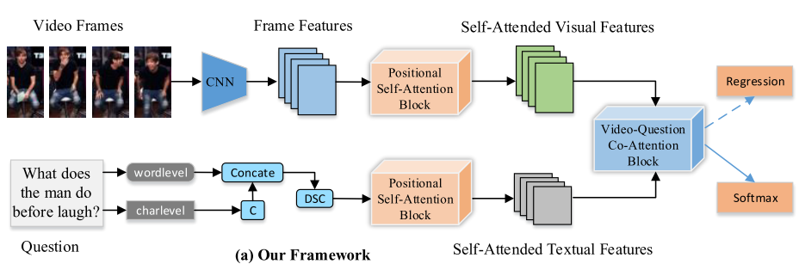
Proposed Method
Figure 1: The overview of our proposed framework

Slide 11
Proposed Method
Figure 1: The overview of our proposed framework

Slide 12
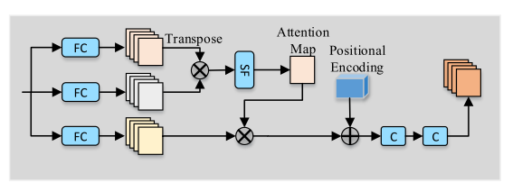
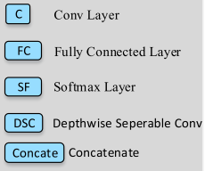
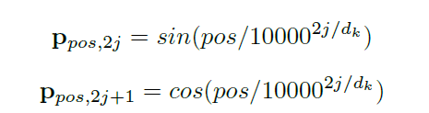
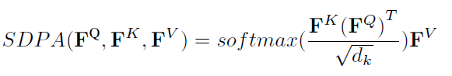
Proposed Method
Details about Positional Self-Attention Block

Slide 13
Proposed Method
Figure 1: The overview of our proposed framework

Slide 14
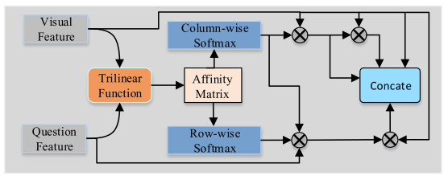
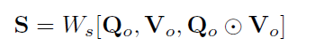
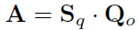
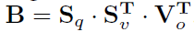
Proposed Method
Details about Tri-Linear Co-Attention
Tri-linear function:

Slide 15
Outline
Introduction
Related Work
Proposed Method
Experiments and Results

Slide 16
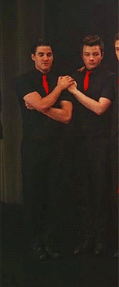
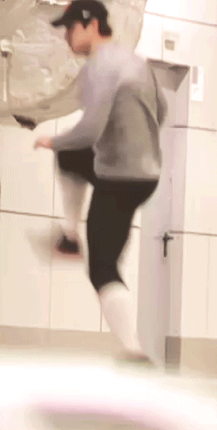
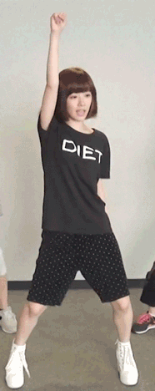
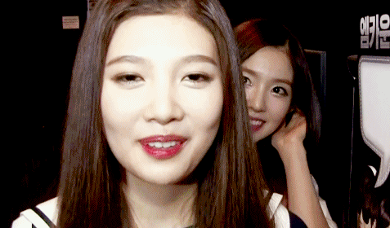
Experiments and Results
Dataset: TGIF-QA contains four tasks
Transition
Action
Count
FrameQA
 | Trans. | Action | Count | FrameQA
Type | Multi-Choice | Multi-Choice | Number | Open-Ended
Evaluation | ACC | ACC | MSE | ACC

Slide 17
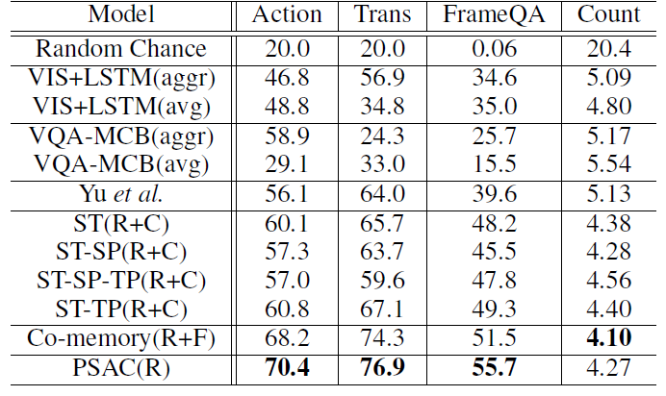
Experiments and Results
evaluation
Comparison with the state-of-the-art methods on TGIF-QA dataset.
R denotes ResNet feature, C denotes C3D feature and F denotes flow CNN feature

Slide 18
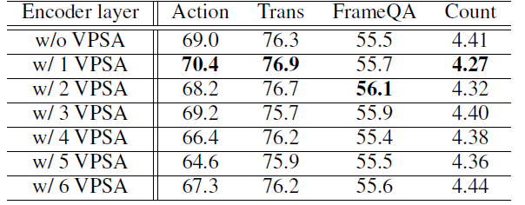
Experiments and results
The effect of VPSA. The w/L VPSA indicates our model with L stacked VPSA layers. The experiments are conducted on the TGIF-QA dataset.

Slide 19
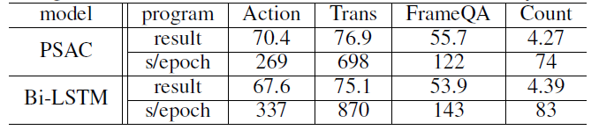
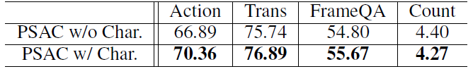
Experiments and Results
Comparison results and time cost (seconds) on visual positional self-attention (VPSA) and Bi-LSTM layer
The effect of character embedding: without or with
word character information

Slide 20
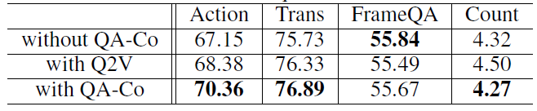
Experiments and Results
The effect of video question co-attention block

Slide 21
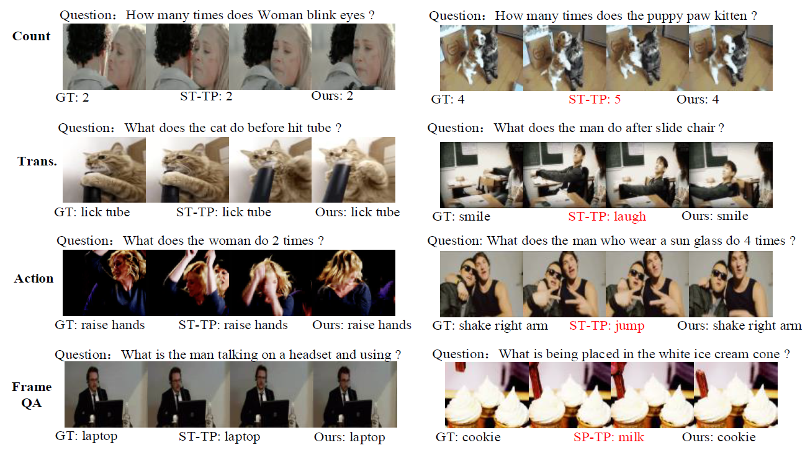
Experiments and Results

Slide 22
Conclusion
We proposed a novel positional self-attention mechanism to replace tradition RNN, which is the first try in visual QA task.
Tri-Linear co-attention enables the model attending to both relevant and important visual and textual features, which removes the irrelevant video and textual information to guarantee the generation of accuracy.
Experimental results on four tasks demonstrate the efficiency and effectiveness of our proposed PSAC architecture.

Slide 23
Thank you!

